Slide 1
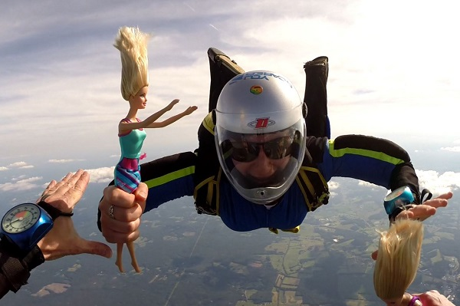
RET is Funded By: The National Science Foundation Grant # EEC-1404766
Save Barbie
Lydia Smoot
Aerospace Engineering, COFSP Fellow Reading High School, Engineering Class

Slide 2
Unit Overview
Standards:
H.S. Forces and Interactions (HS-PS2-1)
ONLS p330: Physical Science – Forces, Momentum, and Motion
Topic: Design and build a parachute that will slow Barbie’s fall and allow her to land softly on the ground.

Slide 3
Activity Highlights
Save Barbie
Guiding Questions:
What factors are we dealing with? Which ones are constant & which change?
Based on what we know and have learned, can we predict the performance of the initial design?
What are the key features of the parachute design and why are they important?
How does air resistance affect the parachute?
What does this tell us about gravity, free fall, and air resistance?
Objectives:
Identify independent & dependent variables, and controls for the experiment
Formulate a hypothesis
Design, manufacture, & test 2 parachute designs
Track Fall-Time with stopwatch and record data
Summarize & share results
Draw conclusions about the properties of air resistance

Slide 4
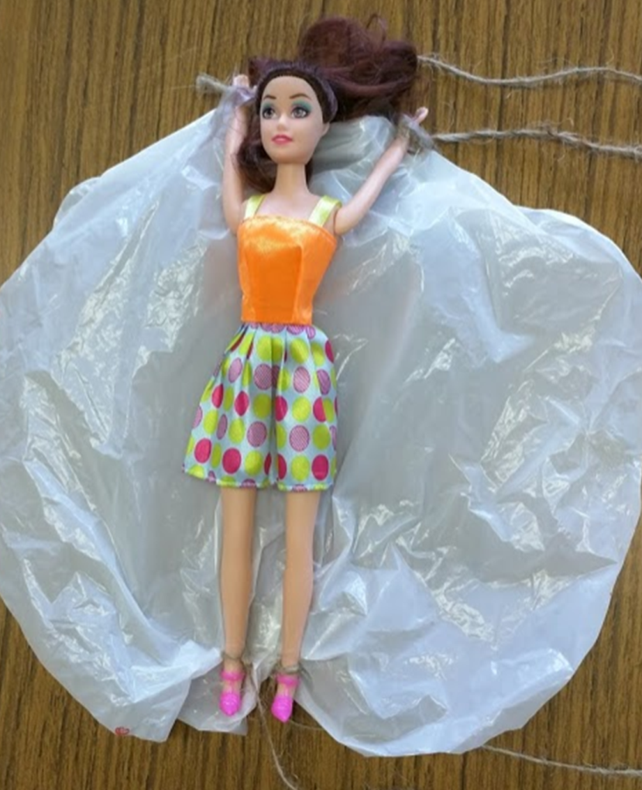
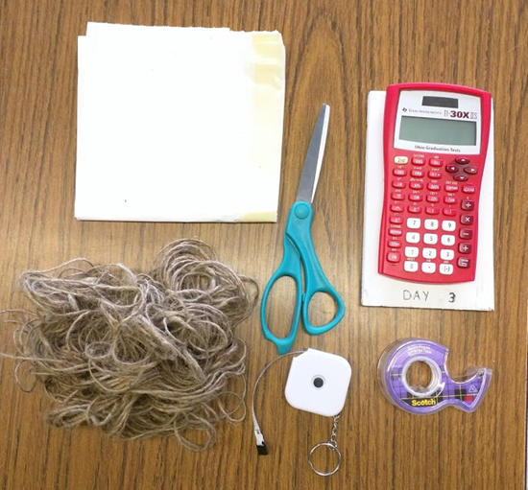
Activity Highlights
Save Barbie
Determine how surface area of parachute effects the air resistance and velocity of Barbie during her fall.
Topic was introduced with fun video
Team members were assigned tasks
Teams went to work designing
and drop testing their parachutes
Student Parachute Design
Materials

Slide 5
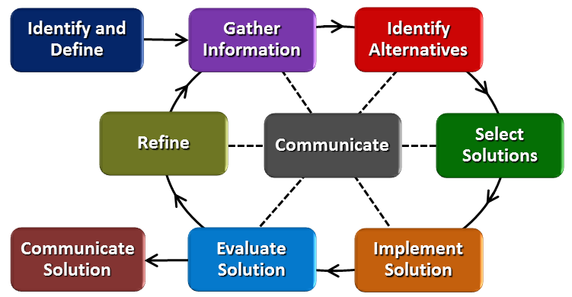
ACS
Students worked to identify problem, develop plan & design, test design, improve & change design, re-test, record & share results
Applying EDP to all problems to create solutions
Careers in Military, Aircraft Safety, Engineering, Product Design, and Extreme Sports
Society benefits from the development of safer products
Engineering Design Process

Slide 6
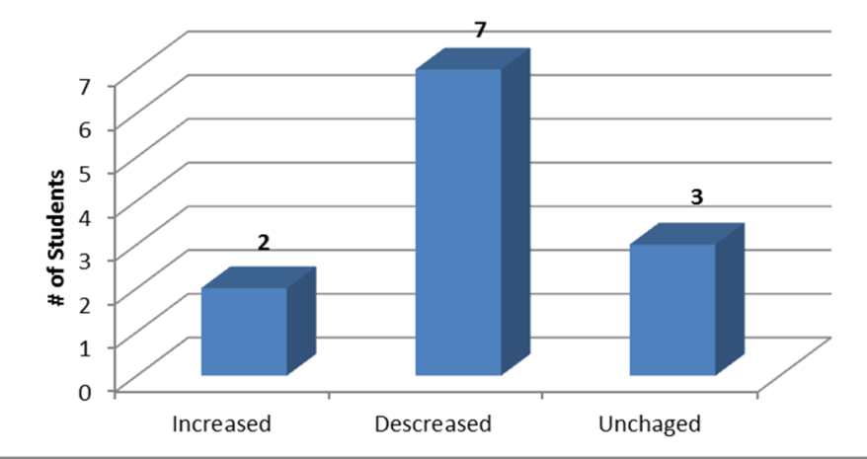
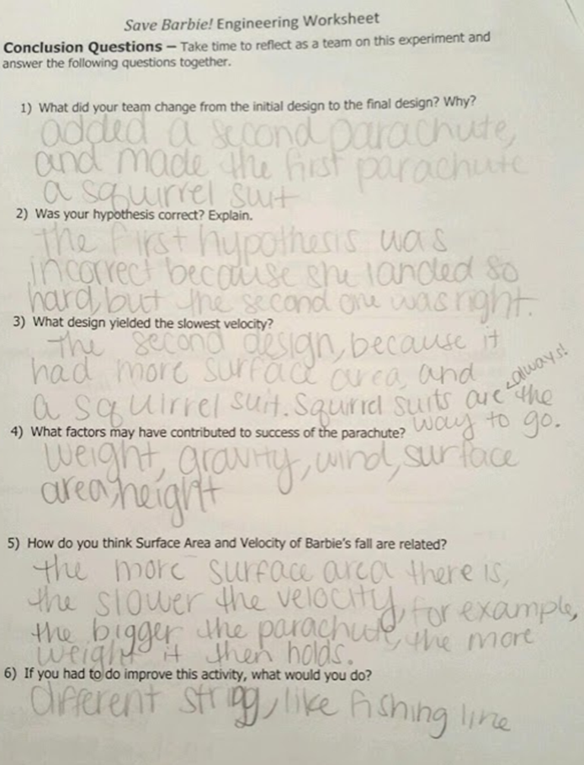
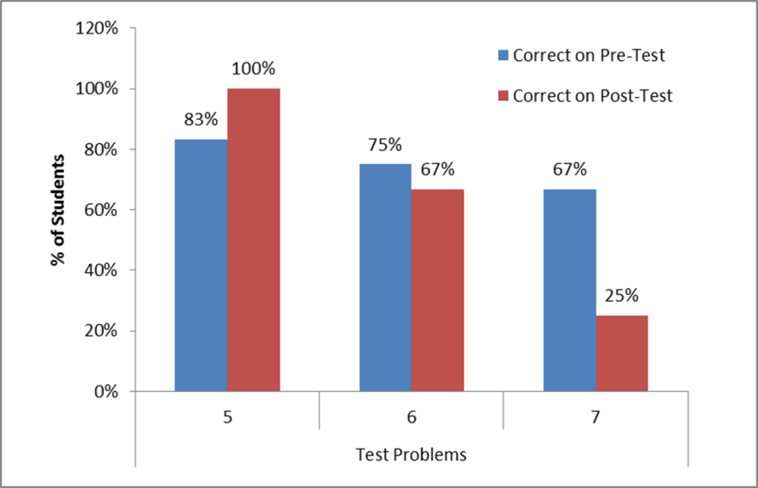
Evidence of Learning
Misconceptions about physics concepts revealed
Scores did not improve from Pre to Post Test

Slide 7
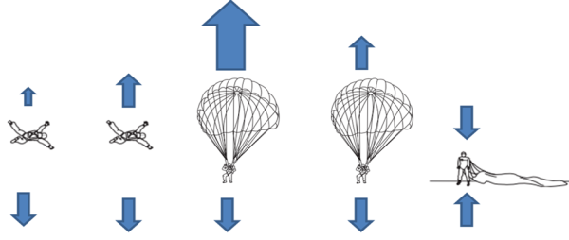
Reflections
Student Feedback: They Had So Much Fun!
Challenged their preconceptions on gravity, free fall, air resistance, velocity, and surface area in a new way.
Improvements:
Introduce topics of air resistance and gravity before beginning activity in the classroom
Allow more time for activity
Improve & clarify pre/post tests

